Slide 1
STAT 717: Class 14
Discriminant Analysis
Vitaly Druker
December 11th, 2021

Slide 2
Introduction
Methods are designed to reduce dimensionality and portray relationships among observations or variables
Discuss:
Multidimensional Scaling
Correspondence Analysis
Biplots

Slide 3

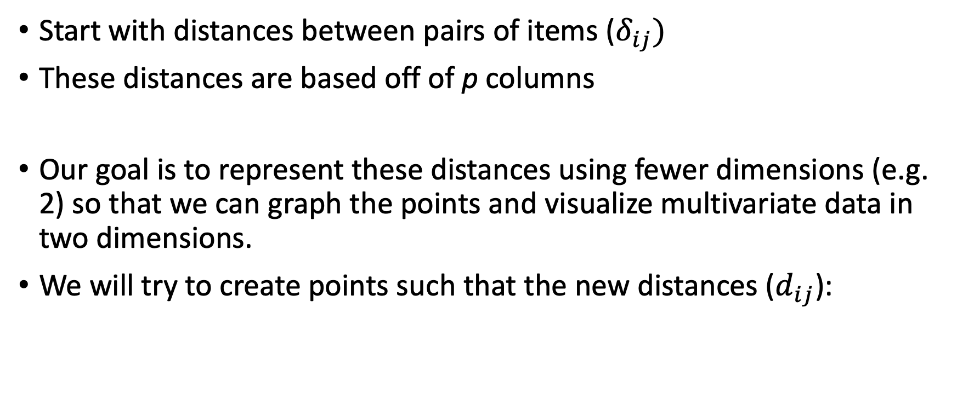
Multidimensional Scaling
Start with distances between pairs of items ($δ_{ij})$
These distances are based off of p columns
Our goal is to represent these distances using fewer dimensions (e.g. 2) so that we can graph the points and visualize multivariate data in two dimensions.
We will try to create points such that the new distances ($d_{ij}$):

Slide 4
Types of multidimensional scaling
Metric multidimensional scaling
Raw data or actually computed distances are available
Nonmetric
Spatial representation only preserves the rank ordering of the values.

Slide 5
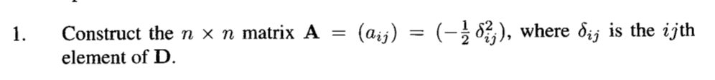
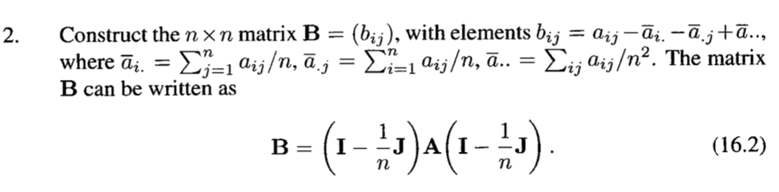

Metric Multidimensional Scaling
Start with n x n distance matrix $\text{D}=(δ_{ij})$
It can be shown that there exists a q-dimensional solution if Bb is positive semidefinite of rank q

Slide 6
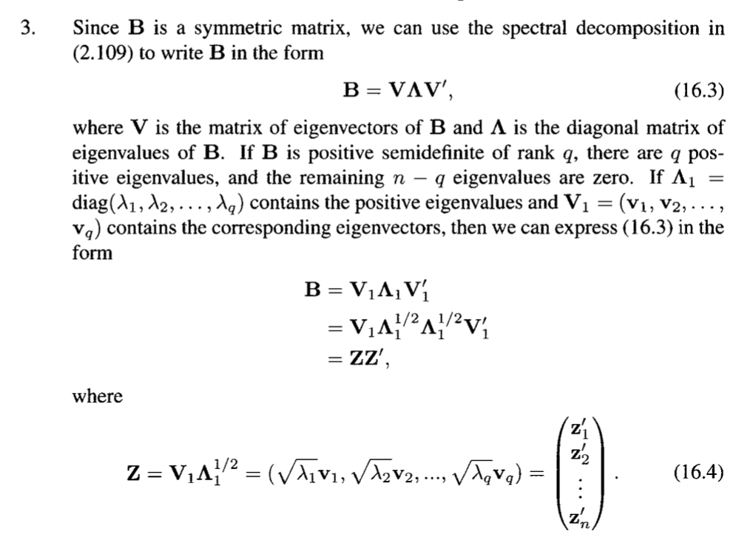
Metric Multidimensional Scaling

Slide 7
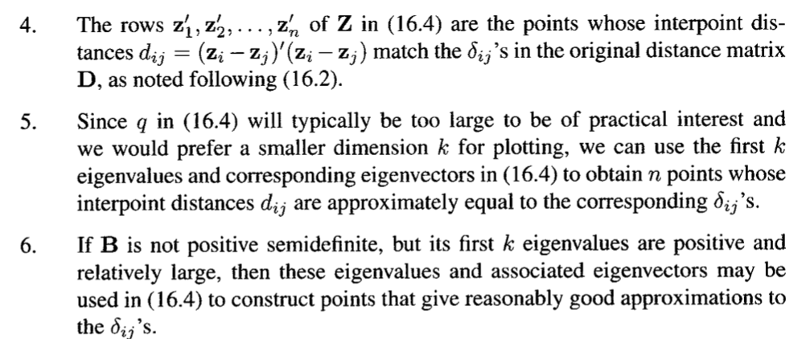
Metric Multidimensional Scaling

Slide 8

Non-metric multidimensional scaling
Suppose that the dissimilarities $δ_{ij}$ cannot be measured by can be ranked
In nonmetric scaling we look to find $d_{ij}$ that are ranked in the same order as $δ_{ij}$

Slide 9
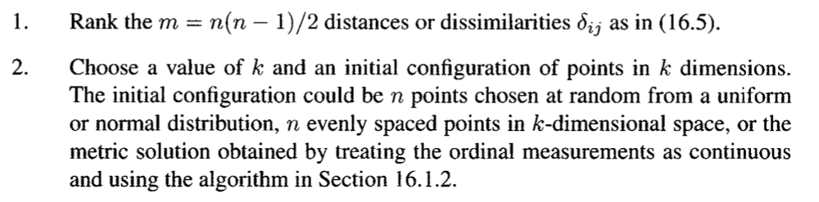
Non-metric multidimensional scaling

Slide 10
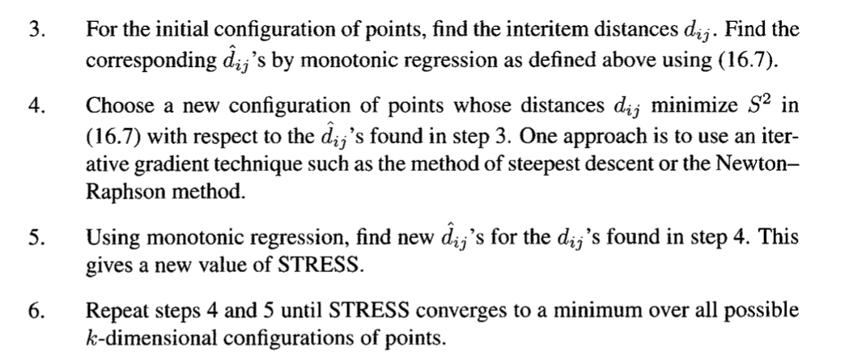
Non-metric multidimensional scaling

Slide 11
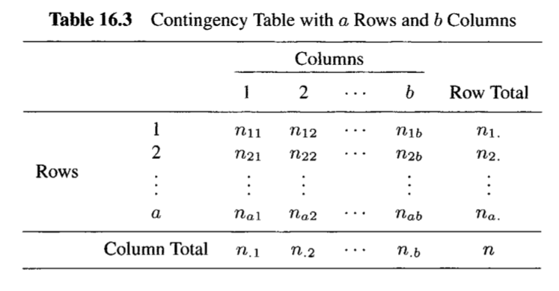
Correspondence Analysis
Graphical technique for representing the information in a two-way contingency table.
Goal is to plot a point for each row and a point for each column

Slide 12
Introduction continued
If two row points are close together then the profiles of the two rows are similar and similarly to two column points.
If a row point is close to a column point then that combination occurs more often than chance expects

Slide 13

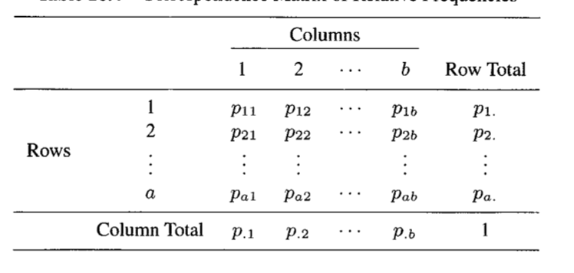
Row and Column Profiles

Slide 14
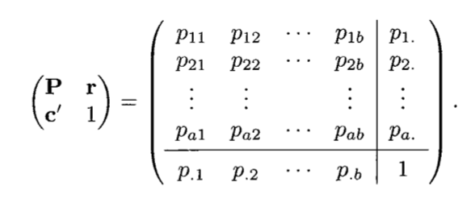
Row sums/column sums row/column masses
Remember – r is an a x 1 matrix
c’ is an 1 x b matrix

Slide 15
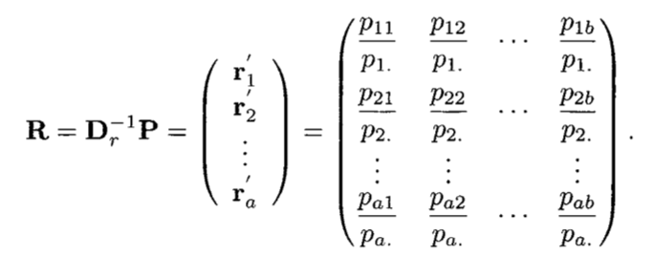
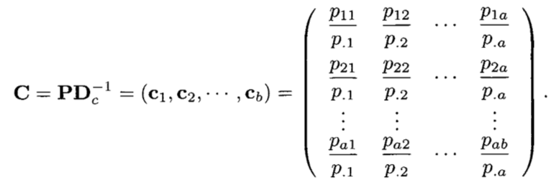
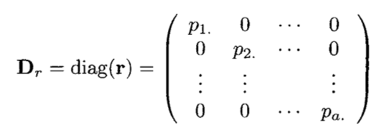
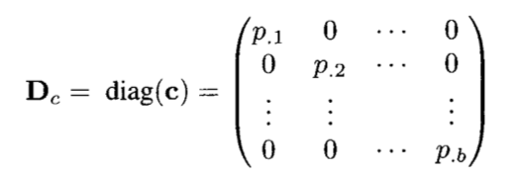
Convert each row and column of P to a profile

Slide 16
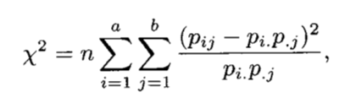
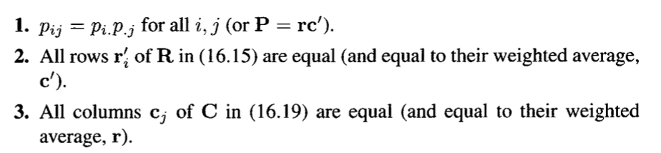
Testing Independence
Where chi-square id random variable with (a-1)(b-1) degrees of freedom

Slide 17

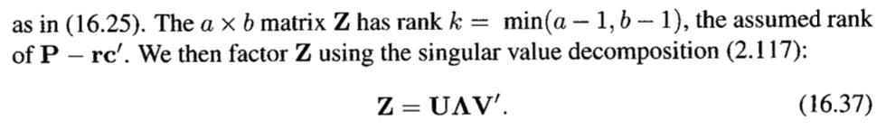



Coordinates for Plotting Row and Column Profiles
Scale P-rc’

Slide 18
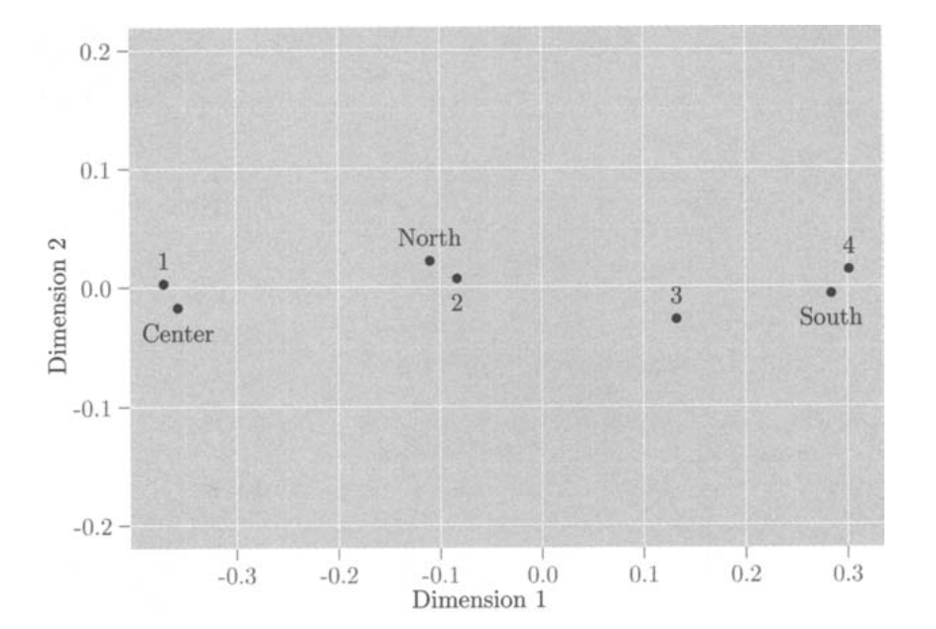

Slide 19
BiPlots
Shows a representation for each row and each column
When p = 2 then a scatterplot works
Each row is represented by a point and the two axes represent the variables
When p > 2 then use PCA/SVD

Slide 20
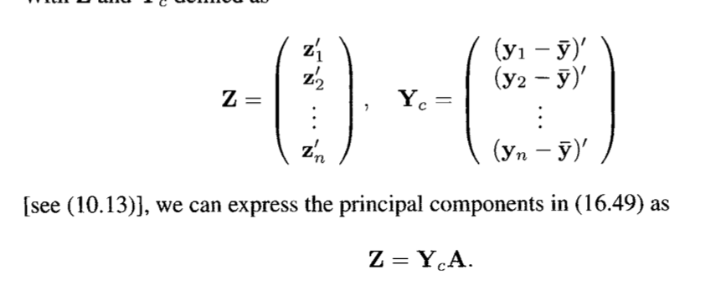
Principal Component Plots
Create principal components as usual
A is a matrix of eigen vectors
A contains representation of columns
Z contains representation of points

Slide 21



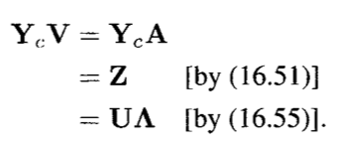

We can do the same thing with SVD

Slide 22
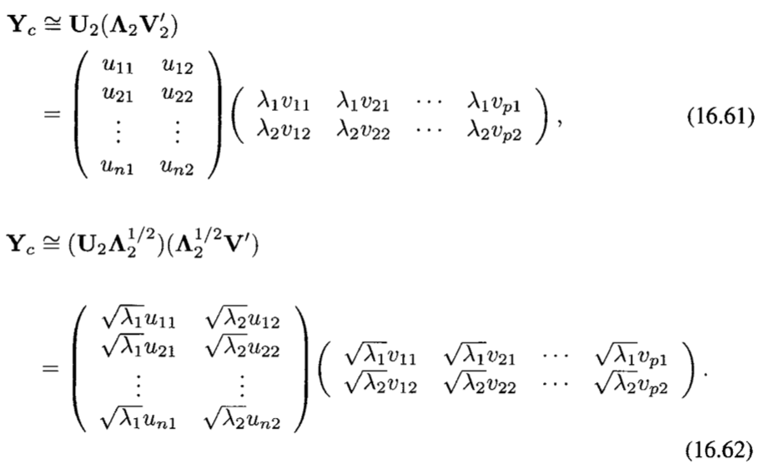

SVD – Plotting – alternative representations
These show the first two columns of the respective matricies

